Slide 1
1 Thessalonians 1:1-10
a cd of this message will be available (free of charge) immediately following today’s service
a podcast will be available later in the week at calvaryokc.com
This Photo by Unknown Author is licensed under CC BY-SA

Slide 2
Reasons Why I Never Wash:
I was forced to as a child.
People who wash are hypocrites - they think they are cleaner than everybody else.
There are so many different kinds of soap; each one claims to be the best
I used to wash, but I got bored and stopped.
I wash only on special occasions, like Christmas and Easter.
1 Thessalonians 1:1-10

Slide 3
Reasons Why I Never Wash:
None of my friends wash.
I’ll start washing when I get older and dirtier.
I can’t spare the time.
The bathroom is never warm enough in the winter or cool enough in the summer.
People who make soap are only after your money.
I don’t like the songs people sing in the bathroom.
1 Thessalonians 1:1-10

Slide 4
Reasons Why I Never Wash:
I know how to stay clean without washing.
The last time I washed, someone was rude to me.
What I do doesn’t affect anybody but me.
I know someone who washes every day and still smells bad.
I don’t believe in soap. I sat beside a whole case of it for an hour once, and nothing happened.
1 Thessalonians 1:1-10

Slide 5
Reasons Why I Never Wash:
Washing was invented by people who knew nothing about science.
I’m so dirty now that if I washed, the drain would clog.
Washing is for women and children.
Washing is for people much dirtier than I am.
I only believe in things I can see, and I can’t see bacteria.
1 Thessalonians 1:1-10

Slide 6
Reasons Why I Never Wash:
There are lots of clean people who never wash.
I feel as close to washing on the golf course as I do in the bathroom.
Washday is the only day I have to sleep in.
My wife washes enough for the whole family
Washing is the opiate of the masses.
1 Thessalonians 1:1-10

Slide 7
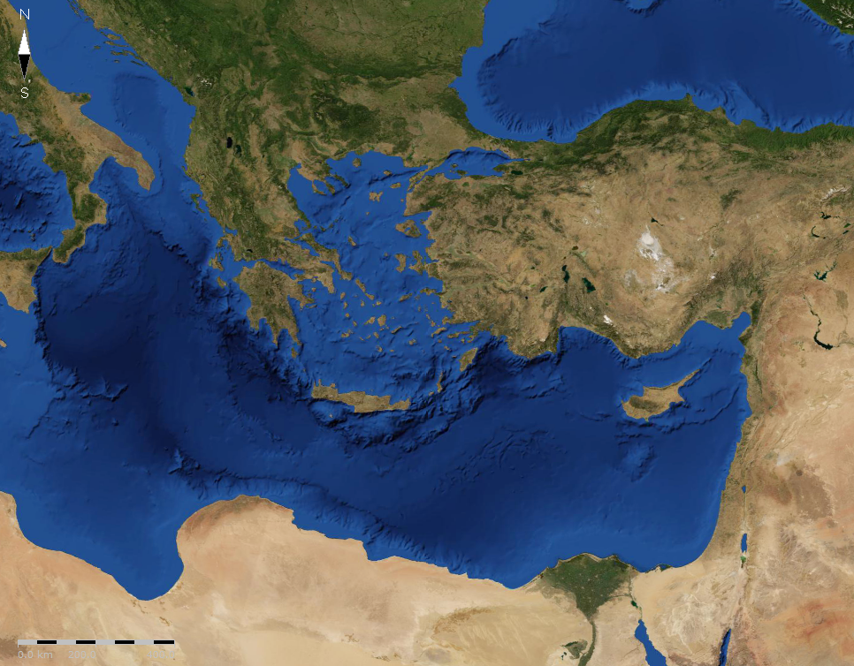
1120 km
Philippi
Dyrrachium
Berea
Byzantium
Troas
Thessalonica
Thessaloniki
Therma
Cicero ~ “The bosom of the Roman Empire”
Via Egnatia
1 Thessalonians 1:1-10

Slide 8
Acts 17:11 ~ These (the Bereans) were more fair-minded than those in Thessalonica, in that they received the word with all readiness, and searched the Scriptures daily to find out whether these things were so.
NASB ~ noble-minded
NIV ~ noble character
eugenēs – well-born
1 Thessalonians 1:1-10

Slide 9
Dry up
Blow up
Holy
Bible
Holy
Spirit
Grow up
1 Thessalonians 1:1-10

Slide 10
1 Thessalonians 1:1-10

Slide 11
Return of Christ
Old Testament
New Testament
17 out of 39 Old Testament books
23 out of 27 New Testament books
7 out of every 10 chapters
60% of the entire Bible
1 Thessalonians 1:1-10

Slide 12
1 Thessalonians 1:1-10

Slide 13
1 Thess. 4:16-17 ~ ¹⁶ For the Lord Himself will descend from heaven with a shout, with the voice of an archangel, and with the trumpet of God. And the dead in Christ will rise first. ¹⁷ Then we who are alive and remain shall be caught up together with them in the clouds to meet the Lord in the air. And thus we shall always be with the Lord.
1 Thessalonians 1:1-10

Slide 14
1 Thessalonians 1:1-10

Slide 15
1 Thess. 1 ~ ¹ Paul, Silvanus, and Timothy,
To the church of the Thessalonians in God the Father and the Lord Jesus Christ:
Grace to you and peace from God our Father and the Lord Jesus Christ.
² We give thanks to God always for you all, making mention of you in our prayers, ³ remembering without ceasing your work of faith, labor of love, and patience of hope in our Lord Jesus Christ in the sight of our God and Father,
1 Thessalonians 1:1-10

Slide 16
1 Thess. 1 ~ ⁴ knowing, beloved brethren, your election by God. ⁵ For our gospel did not come to you in word only, but also in power, and in the Holy Spirit and in much assurance, as you know what kind of men we were among you for your sake.
⁶ And you became followers of us and of the Lord, having received the word in much affliction, with joy of the Holy Spirit, ⁷ so that you became examples to all in Macedonia and Achaia who believe.
1 Thessalonians 1:1-10

Slide 17
1 Thess. 1 ~ ⁸ For from you the word of the Lord has sounded forth, not only in Macedonia and Achaia, but also in every place. Your faith toward God has gone out, so that we do not need to say anything. ⁹ For they themselves declare concerning us what manner of entry we had to you, and how you turned to God from idols to serve the living and true God, ¹⁰ and to wait for His Son from heaven, whom He raised from the dead, even Jesus who delivers us from the wrath to come.
1 Thessalonians 1:1-10

Slide 18
1 Thessalonians 1:1-10

Slide 19
work ~ ergon – idea of vocation or occupation
1 Thessalonians 1:1-10

Slide 20
1 Thessalonians 1:1-10

Slide 21
labor ~ kopos – to work to the point of exhaustion, fatigue
Thomas à Kempis (c. 1380-1471) ~ “A wise lover values not so much the gift of the lover as the love of the giver.”
1 Thessalonians 1:1-10

Slide 22
1 Thessalonians 1:1-10

Slide 23
patience ~ hupomonē – to remain under
Vince Lombardi ~ “Think of only three things: your God, your family and the Green Bay Packers – in that order.”
1 Thessalonians 1:1-10

Slide 24
faith
work of , labor of , and patience of
love
hope
1 Thessalonians 1:1-10

Slide 25
1 Thessalonians 1:1-10

Slide 26
beloved of God ~ Hebraism reserved only for greatest of Jewish heroes
election ~ eklogē – 7x
“Try to understand God’s election and you may lose your mind
… but try to explain it away and you may lose your soul”
1 Thessalonians 1:1-10

Slide 27
DIVINE
HUMAN
Power
ASSURANCE
IN GOD WE TRUST
IN GOD WE TRUST
1 Thessalonians 1:1-10

Slide 28
1 Thessalonians 1:1-10

Slide 29
sounded forth ~ exēcheomai – to roar, reverberate
1 Thessalonians 1:1-10

Slide 30
1 Thessalonians 1:1-10

Slide 31
serve ~ douleuō – verb form of doulos
Literally, serving
1 Thessalonians 1:1-10

Slide 32
1 Thess. 5:6 ~ Therefore let us not sleep, as others do, but let us watch and be sober.
Rom. 13:11-12 ~ ¹¹ And do this, knowing the time, that now it is high time to awake out of sleep; for now our salvation is nearer than when we first believed. ¹² The night is far spent, the day is at hand. Therefore let us cast off the works of darkness, and let us put on the armor of light.
1 Thessalonians 1:1-10

Slide 33
1 Thess. 5:9a ~ For God did not appoint us to wrath,
1 Thessalonians 1:1-10

Slide 34
1 Thessalonians 1:1-10

